Slide 1
Project - 1 Data
Preprocessing
Presentation By -
Suraj Rawat
Yesha Shah
Khushali Upadhyay

Slide 2
Outlines
What is Data Preprocessing?
Dataset from Data Pre-processing Tutorial
Our dataset
Introduction
Comprehensive set of techniques
Steps of pre-processing
Insights
Training and test data
Challenges
Conclusion
Contribution

Slide 3
What is Data Preprocessing?
A data mining technique where raw data is wrangled into much more understandable and desired form.
Raw data consists of incomplete, inconsistent, unusual trends, and sometimes redundant which is not helpful in predicting any trend.
Some steps of data preprocessing:
Integration
Cleaning
Normalization
Transformation
Reduction Tasks - Complexity of data, detecting/removing irrelevant and noisy elements from data through feature selection, instance selection etc.

Slide 4
Dataset from Data-Preprocessing Tutorial
Dataset for preprocessing was taken from UCI machine learning repository containing information about breast cancer patients.
There were a lot of missing values, outliers, duplicate rows and fields with strings in it so cleaning was necessary.
The techniques used for cleaning/preprocessing are
Discarding missing values
Discarding outliers
Discarding duplicate rows
Dropping fields with strings
Dimensionality reduction/ Principal Component Analysis
After implementing the above techniques, the dataset obtained was clean.

Slide 5
Our Dataset - Introduction
The domain that we chose was “Hourly Weather Surface - Brazil (Southeast region)
It covers hourly weather data from 122 weather stations of southeast region of Brazil. Clearly this data is based on time series. Hence, it is a sequential dataset.
The dataset that we chose is located in the following link:-
https://drive.google.com/drive/folders/1DHXuSRDZQyTo9VrbKFhryNVc63NwYRc8
The dataset we chose was very unclean containing missing values, outliers, duplicate rows and fields with strings so we had to implement the techniques described in the preprocessing tutorial to clean data.

Slide 6
Comprehensive set of techniques
Missing values :- It is possible to have missing attributes values because either the information was not collected or some attributes are not applicable to data instances. Convert the missing values to NaNs and calculate columns containing missing values and then there are 2 methods : 1) Replacing missing values with median of that column and 2) Discarding data points containing missing values.
Outliers :- Some data instances will have completely different characteristics from the rest of dataset and they are not relevant so it becomes necessary to identify outliers by drawing box plots. If any columns contain string values we convert them into numeric to draw box plot. To discard the outliers, we compute the Z-score for each attribute and remove those instances containing attributes with abnormally high or low Z-score.
Duplicate data :- Some data sets obtained by merging multiple data sources are duplicate so it becomes important to identify duplicate rows and discard them.
Dropping fields :- Some fields in the data set are of no value so it becomes necessary to drop such fields.
Dimensionality reduction/Principal Component Analysis:- To convert higher dimension data into lower dimension data. Discussed at the last.

Slide 7
Steps of Pre-processing
Firstly, the dataset we chose had many columns containing strings and unnecessary values. So we dropped those columns in order to get a dataset containing the important columns.
Secondly, we had many missing values so we first identified the columns with missing values and replaced them with median in the 1st method. In the 2 nd method, we discarded the columns with missing values.
Thirdly, we had outliers in our dataset so we drew box plots to identify columns with outliers and then used Z-score method to discarded the outliers.
We also identified the duplicate values and discarded the rows having duplicate values.
We had so many string fields so we eliminated those fields by using the drop method.
We had a lot of data which was in higher dimension so we used Dimensionality reduction/Principal Component analysis to convert it into lower dimension to obtain data in an understable form.

Slide 8
Steps of Pre-processing
Dimensionality Reduction/Principal component analysis (PCA) is a classical method for reducing the number of attributes in the data by projecting the data from its original high-dimensional space into a lower-dimensional space. The new attributes (also known as components) created by PCA have the following properties: (1) they are linear combinations of the original attributes, (2) they are orthogonal (perpendicular) to each other, and (3) they capture the maximum amount of variation in the data.The dataset we have used for PCA is a subset of leaf-disease dataset,we mainly used basic
Pepper__bell___Bacterial_spot,
Pepper__bell___healthy
Potato___Early_blight
Potato___healthy

Slide 9
Steps of Pre-processing
Using PCA, the data matrix is projected to its first two principal components. The projected values of the original image data are stored in a pandas DataFrame object named Projected. Next we used a scatter plot to display the projected values with markers to discriminate value of these attributes.

Slide 10
Insights
We have used two types of Data Splitting.The reason is as follows :-
Case - 1 :- Data : Our dataset is sequential (Hourly Weather Surface)
Why are we not splitting data randomly? Because in a sequential dataset , prediction is done using previous day's data (FYI we took climate data) (i.e. Data order is important ). If partition of data is done randomly, the prediction made after that is not going to give true result as it is taking any random day to predict the next day's result.
Case - 2 :- Data : Our dataset is not sequential (Tutorial - 4.ipynb)
“Prediction won’t be affected , because data order is not important”.
Since the number of rows are more in number, then there will not be underfitting but there are chances of results getting overfitted.

Slide 11
Insights
Aggregation
Data aggregation is a preprocessing task where the values of two or more objects are combined into a single object. The motivation for aggregation includes (1) reducing the size of data to be processed, (2) changing the granularity of analysis (from fine-scale to coarser-scale), and (3) improving the stability of the data.
In the example below, we have used ‘15 minute interval’ precipitation time series data for a weather station located at Detroit Metro Airport.Please find the link for data
https://www1.ncdc.noaa.gov/pub/data/cdo/samples/PRECIP_15_sample_csv.csv
We observed that the 15 min interval time series appear to be quite chaotic and varies significantly from one time step to another. The time series can be grouped and aggregated by hourly intervals to obtain more smoothly compared to the 15 minute time interval series.
We didn’t stop there, now we grouped this hourly grouped data , and guess we got more smoothing result which is monthly intervals.

Slide 12
Insights
Sampling
“Sampling is an approach commonly used to facilitate (1) data reduction for exploratory data analysis and scaling up algorithms to big data applications and (2) quantifying uncertainties due to varying data distributions.”
We took data from the following:-
https://www1.ncdc.noaa.gov/pub/data/cdo/samples/PRECIP_15_sample_csv.csv
First we displayed 5 records from data table.
A sample of size 3 is randomly selected (without replacement) from the original data and displayed.
Then we randomly selected 3% of the data (without replacement) and display the selected samples and also we used random_state argument of the function which specifies the seed value of the random number generator.
We performed a sampling with replacement to create a sample whose size is equal to 3% of the entire data. And observed duplicate data.

Slide 13
Insights
Discretization
“Discretization is a data preprocessing step that is often used to transform a continuous-valued attribute to a categorical attribute. The example below illustrates two simple but widely-used unsupervised discretization methods (equal width and equal depth) applied to the 'AverageTemperatureFahr’ attribute value attribute of temperature.csv dataset.”
For the equal width method, we can apply the cut() function to discretize the attribute into 4 bins of similar interval widths. The value_counts() function can be used to determine the number of instances in each bin.
For the equal frequency method, the qcut() function can be used to partition the values into 4 bins such that each bin has nearly the same number of instances.

Slide 14
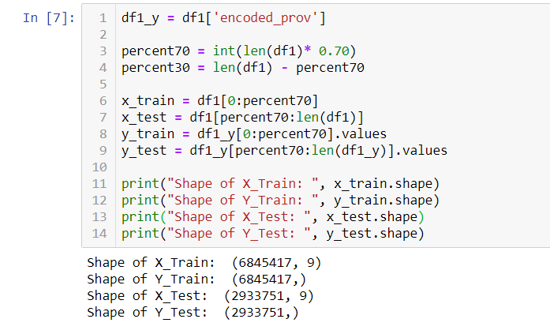
Training and test data
Since our dataset consists sequential type data, we have done splitting as follows:
Created a new column with the predicting column.
Trained the data in sequence with 70:30 ratio for training and testing respectively.
The printed statements shows the size of each train and test.

Slide 15
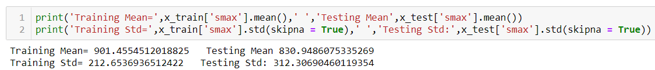
Training and Test Data
With these number of rows we think the model can be well trained and tested. There are absolutely no chance of underfitting.
Below is the measure for both partition of data.

Slide 16
Challenges
We faced challenges like dimensionality reduction, reducing misleading or null data values, removing non-numeric data, underfitting/overfitting, eliminating fields containing string and removing redundant data.

Slide 17
Conclusion
We can say to prepare a processed data we should have in-depth knowledge of the domain of dataset and its attributes values (i.e data types). There could be issues like illegal/unsupported operations performed on data-types which don’t match . (i.e float to int64 so on). We came across different grouping, aggregation and sampling techniques when we have to deal with more specific and concise set of data.

Slide 18
Contribution
Preprocessing and documentation was done by Suraj Rawat, Khushali Upadhyay and Yesha Shah.

